Slide 1

ED Encounters by Homeless Patients in Healthcare Shortage Areas
Elizabeth King
MIS 581-1 Capstone: Business Intelligence and Data Analytics
Colorado State University – Global Campus
Dr. Justin Bateh
February 12, 2023
Notes:
Hello. I’m Elizabeth King, and this is my capstone project for Data Analytics and Business Intelligence. The research project is called “Emergency Department Encounters by Homeless Patients in Healthcare Shortage Areas.”

Slide 2
Introduction
What? U.S. emergency departments (EDs)
Who? Ill-housed citizens
Why? Appropriate resource allocation
How? Data analytics
Notes:
Introduction
This research project was on the topic of the utilization of the emergency department by the homeless population. It was expected that research on emergency room visits among these patients would expose trends that could be further investigated to solve business problems. Specifically, research questions regarding the use of the emergency department in regions with a shortage of primary care and mental health resources was targeted as a focus within the data analyses.

Slide 3

Purpose
&
Objectives
Reveal tendencies in ED utilization
Predict the nature of future ED visits
Contribute to existing body of knowledge
Expand research on the topic
Apply insight to other parts or populations of the country
Reveal healthcare patterns in the homeless community
Lead to further research to solve problems
Notes:
Purpose Statement
This research project focused on the use of the California emergency department, using a data set from 2019 (State of California, 2021). Findings from available data were expected to reveal notable patterns in healthcare usage among one of the nation’s most vulnerable groups. Significant results from this research project could be used to make important decisions for the future of healthcare.
Objectives
The goal of this proposed research project was to reveal additional tendencies in healthcare utilization, specifically emergency department services and to possibly predict the nature of future emergency department encounters. This research project should contribute to the existing body of research on the topic. Similar studies have been conducted in Massachusetts, New Jersey, Oregon, and Toronto, Ontario. Insights from data collected in California could contribute to a comprehensive understanding of the country’s healthcare.
Another objective of this project was to gain insights on the use of the American healthcare system by both homeless patients and non-homeless patients. The findings from this project could lead to further research concerning financial costs and expenditures, Medicaid and other healthcare payer reform, the importance of community services for the unhoused, and possibly the reallocation of existing resources for such groups.

Slide 4
Quantitative Study Overview
Models and Predictions
Visualizations
Data Gathering
Logistic regression predictive model
Descriptive analyses using charts and graphs
Historical data from the state of California
Notes:
Study Overview
This was a non-exhaustive quantitative study on healthcare utilization trends only in the state of California during the year 2019. Following data gathering, visualizations were created to make sense of the data. Statistical analyses on the dataset broke the data down into more easily digestible material, and visualizations illustrated the findings in ways that most information-literate readers could understand sufficiently. Then a logistic regression model was built.

Slide 5
Research Question and Hypotheses
Where should resources be allocated in order to accommodate emergency department visits from homeless patients?
H₀: There is no statistically significant relationship between the variables Primary Care Shortage Area and Homeless Indicator.
H_{A}: There is a statistically significant relationship between the variables Primary Care Shortage Area and Homeless Indicator.
H₀: There is no statistically significant relationship between the variables Mental Health Shortage Area and Homeless Indicator.
H_{A}: There is a statistically significant relationship between the variables Mental Health Shortage Area and Homeless Indicator.
Notes:
Research Question
The problem that this research project attempted to address was a hypothetical one. Considering there dataset, the fact that there is data on emergency department encounters by homeless patients in areas that were experiencing some type of healthcare shortage signaled that there may be a relationship between or among this data. A school of thought on the matter claims that unnecessary emergency room visits increase when the individual patients lack access to primary care (McFadzean et al., 2022). Frequent emergency department visitors present perceived or true urgent mental health crises at high rates, overcrowding hospitals (Armoon et al., 2022). These facts indicate that a shortage of primary care or mental health resources poses a problem in regards to emergency department use.
So the research question was: Where should resources be allocated in order to accommodate emergency department visits from homeless patients? The focus on the relationship between primary care and mental health shortages narrowed the research project down to factors that affected emergency department usage among the homeless population already documented in literature (Feldman et al., 2021).
Hypotheses
Two hypotheses were formed in order to run statistical tests on the data. The null hypotheses state that there is no relationship between the shortage area variables and the homeless indicator variables. The alternate hypotheses claim that there is a relationship.
[H0: There is no statistically significant relationship between the variables Primary Care Shortage Area and Homeless Indicator.
HA: There is a statistically significant relationship between the variables Primary Care Shortage Area and Homeless Indicator.
H0: There is no statistically significant relationship between the variables Mental Health Shortage Area and Homeless Indicator.
HA: There is a statistically significant relationship between the variables Mental Health Shortage Area and Homeless Indicator.]
A logistic regression model would determine if any relationships were significant. If all of the regression coefficients in the model were equal to zero, there would be no relationship between the variables. Predictions would be made in terms of probability. This research project aimed to be able to predict the probability that emergency department visits will be made by homeless individuals based on input variables determined by the model. All aforementioned tests, models, and predictions were run in R using the Generalized Linear Model functions.

Slide 6
Literature Review
Data reveals the following:
Improved, affordable healthcare coverage improves health outcomes
Stable housing reinforces positive health outcomes
Community outreach program utilization further improves outcomes
Frequent ED users ensue because of:
Lack of access to primary care (i.e. geographic constraints)
Exacerbated in areas with a shortage of primary care physicians
Un- or undertreated mental illness
Exacerbated in areas with a shortage of mental health resources
Homelessness disadvantages:
Chronic illness, comorbidities, high mortality, nutritional deficiency, poor hygiene, substance abuse psychological illness
Exacerbation of all conditions due to unstable housing situations
Seemingly endless poverty cycles lead to worse health outcomes
Notes:
Literature Review
Many studies have attempted root cause analyses of the mis- and overuse of hospital emergency departments. For instance, many rely on the emergency department for primary care, which could be due to a shortage of primary care physicians in the affected area. Studies have used a myriad of resources such as health insurance data, hospital records, and patient interviews. Many of the studies have resulted in similar findings: [that] more affordable, improved healthcare coverage alone will not drive down unnecessary emergency department or acute care visits (Bharel et al., 2013). The researchers have often agreed that more community outreach programs and services should be more widely available to mitigate over-use of emergency room services (Bharel et al., 2013).
There are several reasons an individual might habitually visit the emergency department. Some patients live in a geographical location where there is either a shortage of primary care physicians or it is simply too difficult for them to arrange transportation to visit the doctor (Burns, 2017). The frequent emergency room user might also visit regularly due to mental health crises perceived to be an emergency or unmanageable by the suffering patient. Homeless individuals are prevalent among those in both cases where the patient chooses to visit the emergency room instead of another type of physician (Behr & Diaz, 2016).
There have been studies on the positive effects that stabilized housing for the homeless has on emergency department over-use (Jaworsky et al., 2016) (Cantor et al, 2020) (Chhabra et al., 2020). Homeless or ill-housed people suffer from many disadvantages other than simply living unsheltered. Such conditions include chronic illness, high mortality, nutritional deficiency, poor hygiene, substance abuse, and psychological illness. The Canadian study conducted by Jaworsky et al. (2016) concluded that stabilized housing reduced the frequent usage of the emergency department and had a positive correlation with homeless subjects receiving better healthcare. These findings were in line with the findings of prior studies, adding the association between stabilized housing and the ability to seek and follow up on primary care services, mitigating emergency department usage (Jaworsky et al., 2016).
Another study from Canada found that many homeless patients presented at an emergency department with mental health related emergencies (Wiens et al., 2022). On-going homelessness can exacerbate mental illness. This study supported findings that stabilized housing will contribute not only to better healthcare outcomes for the ill-housed, but also reduced emergency room visits (Wiens et al., 2022). Additional studies [such as Stergiopoulos et al.’s] (2017) reinforced the fact that homeless people suffer from seemingly never ending cycles of poverty and poor health.

Slide 7
Research Design:
Quantitative & Confirmatory
Explore relationships among variables
Contribute to other studies on matter
Methodology:
Logistic Regression
Hypothesis Testing
Probability Prediction
Methods:
Descriptive Statistics
Visualizations
Logistic regression modelling
Notes:
Research Design & Methodology
The methodology of this quantitative study was chosen based on the nature of the data. The project used a large data set of numeric and categorical variables which contained a wealth of information on frequency counts that describe emergency department encounters across the state. Categorical data could be used to predict probabilities on one or the other events occurring.
Methods
The methods used in this study included descriptive statistics and visualizations. The latter provided clear context for the data. Descriptive statistics pointed out the vastness and range of the data.
A logistic regression model was built to predict the probability of an emergency department visit by a homeless patient. Logistic regression has been chosen based on its ability to output probabilities and odds ratios that could be considered when planning for future outcomes.

Slide 8
Limitations
Ethical Considerations
Single state, California
Groupings of ED encounters generalizes specific data
Data could be inaccurate
Unclear definition of “homeless”
Inpatient hospitalization data omitted
Involuntary institutionalization
Anonymity retained in groupings
Notes:
Limitations
This study was limited to a single state, California. The dataset was limited to groupings of emergency department encounters rather than individual encounters. Additionally, data on homelessness may be inaccurate or skewed. Patients entering a healthcare facility might be reluctant to admit that they are ill-housed or unhoused. It is unclear what criteria was used to determine a patient’s homelessness status in this dataset, so “homeless” could mean sheltered or unsheltered.
Ethical Considerations
Although the focus of this research project was inspired by literature on the oversaturation of emergency departments in general, the comprehensive dataset used did include data on inpatient hospitalizations as well as emergency department encounters. The decision to omit data pertaining to inpatient hospitalizations was made not only on the basis of narrowing the focus of the project, but also the ethical circumstances pertaining to involuntary institutionalization of homeless individuals in hospital settings (Waggoner, 2004). The dataset did not contain indicator variables on whether the hospitalization was voluntary or not, and so was not used in this project.
Finally, the resulting dataset was not composed of observations on individual emergency department encounters. Instead, each observation in the dataset represented a cluster of emergency department encounters, grouped by demographic information. While this may have been considered a limitation to the study, it was also another measure of anonymizing the data.

Slide 9
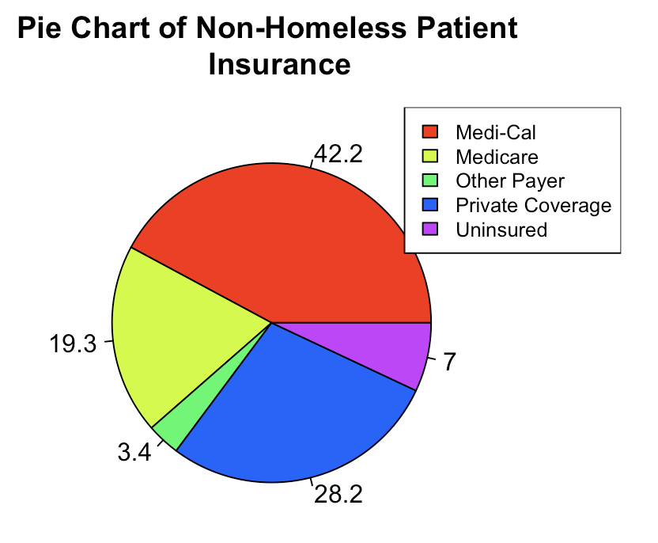
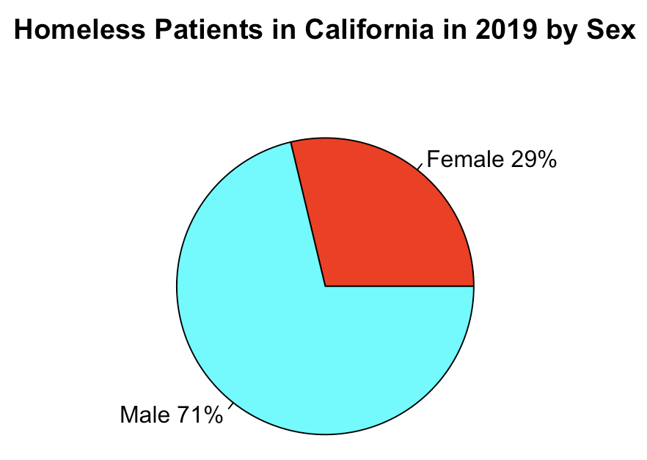
Findings
Descriptive statistics
Highlight magnitude of data and relationships within
Contrast important information in charts
Notes:
Findings
After checking the dataset for missing values, descriptive statistics ensued. Visualizations aided in explaining and understanding the data. Exploring the dataset as a table alone did not provide a clear sense of the meaningful information that the data contained. With 10,744 observations from 317 healthcare facilities, over 23 million total encounters, it was easy to be overwhelmed by the magnitude of this dataset. Grouping the data in a pie chart by demographic displayed the percentage of each group that makes up the whole population within the data set. This slide shows the proportions of the various types of insurance that housed Californians can use for health care.

Slide 10
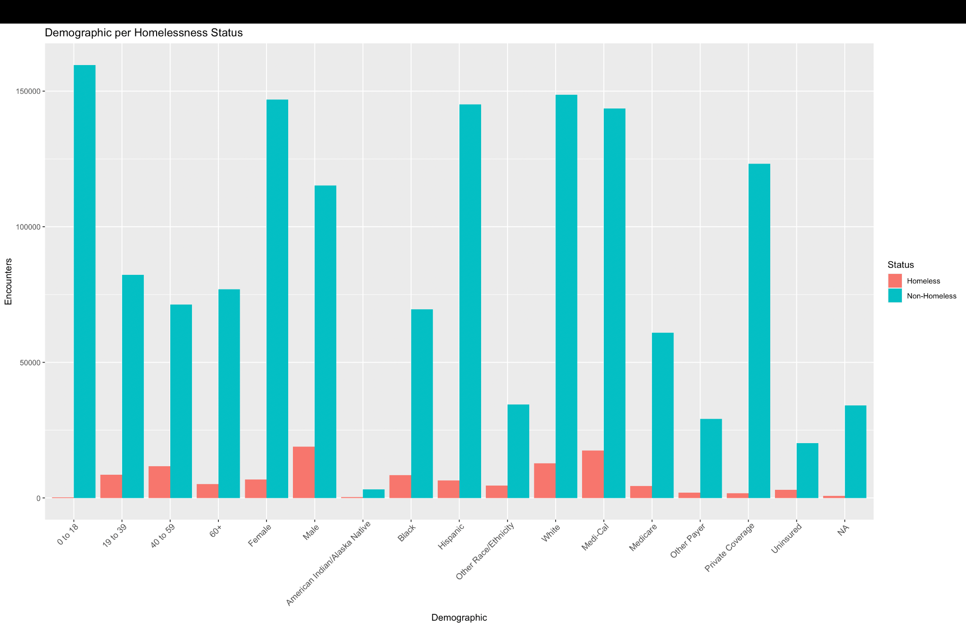
Findings
Descriptive statistics
Highlight magnitude of data and relationships within
Contrast important information in charts
Notes:
This is a bar plot of the 17 demographic attributes contained in the dataset and the total number of encounters per group of patients. For easy comparison, the non-homeless count was paired next to the homeless count for each demographic in starkly contrasting colors. From this chart, the viewer could easily understand differences among homeless patients presenting at the emergency room such as: there were more non-homeless women than men, most Californians used the state’s Medicaid health care program, and most encounters were made by white patients. Another stark contrast is that so few homeless children visited California emergency departments in 2019, yet it is the largest overall demographic makeup of non-homeless emergency room patients.

Slide 11
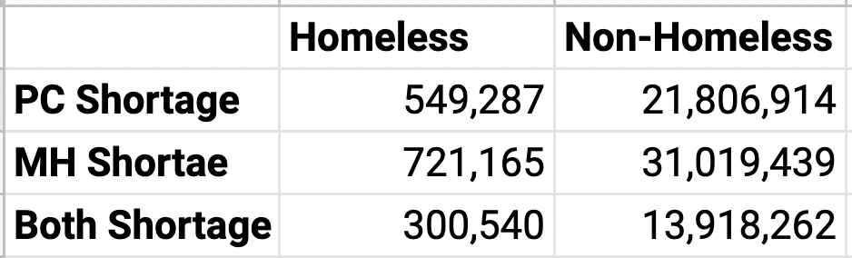
Findings
Frequency counts
Sorting the data
Narrow the scope
Notes:
Filtering the data, the following results were relevant to this study: there were over 500,000 emergency room encounters of homeless patients in an area suffering a shortage of primary care. There were over 700,000 emergency room encounters of homeless patients in an area suffering a shortage of mental health resources. And there were just over 300,000 encounters of homeless patients at the emergency department in an area suffering a shortage of both primary care and mental health resources.

Slide 12
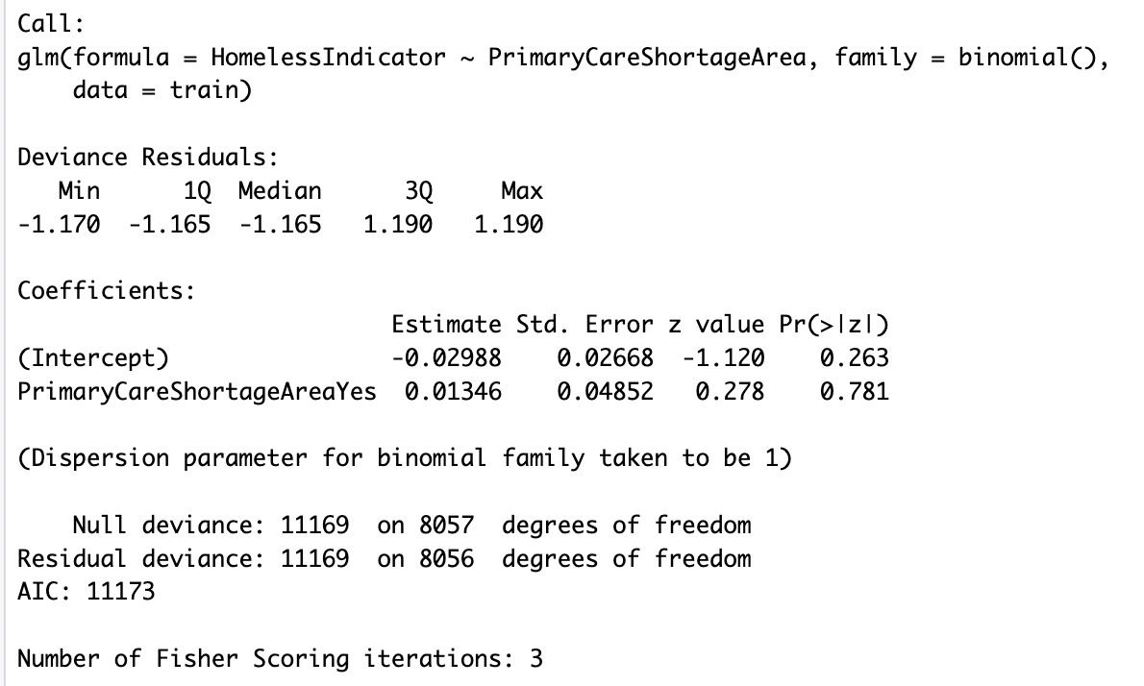
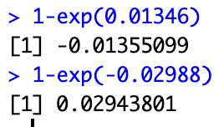
Logistic Regression Model 1
Independent variable:
Primary Care Shortage Area
Event of interest = Yes
Dependent variable:
Homeless Indicator
Notes:
After a subset of training and testing data were partitioned, three logistic regression models were built in R to reveal a potential relationship among the relevant data. The results were unexceptional. When running a logistic regression model holding Primary Care Shortage Area as the independent variable, the coefficients were close to 0. The two P-values listed were much higher than 0.05 to be considered significant. Entering the coefficients into the odds expressions as seen in the slide yielded the following results: The model’s relative effect can merely account for a 1.4% increase in the odds that a patient presenting at the emergency room will be homeless based on the fact that a facility is in a primary care shortage area. The absolute effect of the model demonstrates that the odds of a homeless patient presenting to the emergency department considering no other variables in this model is actually a decrease by 2.9% (Vakhitova & Alston-Knox, 2018). With such high P-values, the null hypothesis could not be rejected.

Slide 13
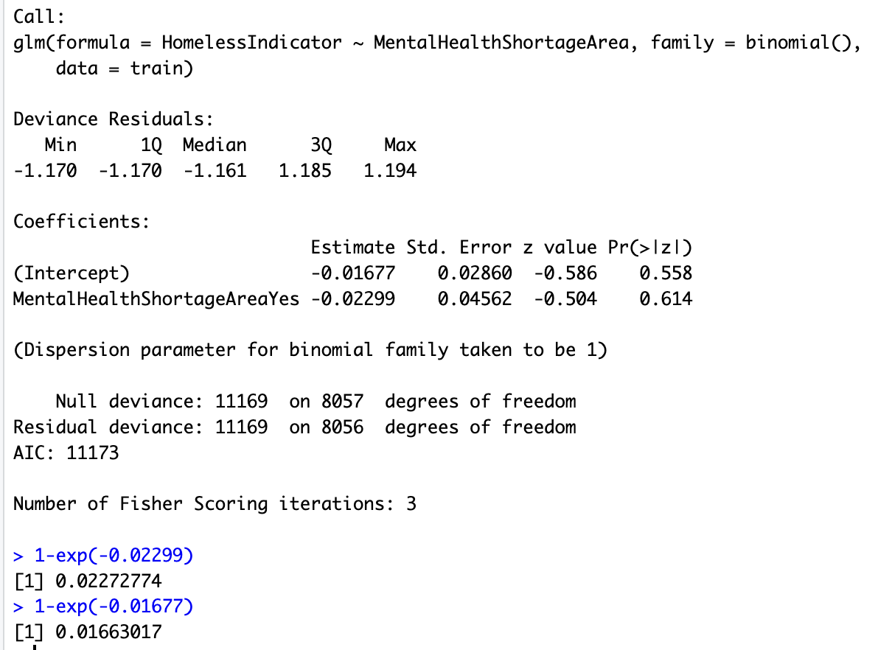
Logistic Regression Model 2
Independent variable:
Mental Health Shortage Area
Event of interest = Yes
Dependent variable:
Homeless Indicator
Notes:
Similarly, a model was built using Mental Health Shortage Area as the predictor variable. The results were not statistically significant, and in fact the resulting odds were counterintuitive. The model’s relative effect determined that these odds decreased by 2.3% in an area with a mental health shortage. The odds decreased by 1.6% holding no other variables as explanatory variables. With such high P-values as seen in the slide, the null hypothesis could not be rejected.

Slide 14
Conclusions
Recommendations
Unable to reject the null hypothesis
Data may have been insufficient
Model was unable to be used to make predictions on ED encounters
Additional research
Further analyses on dataset
Exploration of other datasets
Notes:
Conclusion
The results of logistic regression models have left much to be desired as far as actionable insights on the matter go. The null hypotheses were not rejected. While the data contained indicators of if a homeless patient visited the emergency room in an area with various healthcare shortages, there may not have been enough data to make meaningful correlations or to make predictions.
Unfortunately, the tests run on the data were unable to confidently reveal relationships and make impressive levels of predictions on future emergency room visits. The logistic regression model built has shown to be unreliable when predicting the probability that emergency room visits would be made by homeless patients based on the input variables determined by the model.
Recommendations
Additional research is needed in order to draw meaningful conclusions from the data on emergency department encounters in California. Other datasets can be explored in addition to or in tandem with the dataset used in this project. The variables used for analysis in this project were chosen to be of interest based on the prior research on the lack of healthcare resources for homeless individuals. Other studies have used healthcare record data and U.S. census data. It could be worthwhile exploring other datasets on the same topic in California to detect possible similar trends.

Slide 15
References
Bharel, M., Lin, W.-C., Zhang, J., O’Connell, E., Taube, R., & Clark, R. E. (2013). Health care utilization patterns of homeless individuals in Boston: preparing for Medicaid expansion under the Affordable Care Act. American Journal of Public Health, 103(2), S311–S317. https://doi.org/10.2105/AJPH.2013.301421.
Behr, J. G., & Diaz, R. (2016). Emergency Department Frequent Utilization for Non-Emergent Presentments: Results from a Regional Urban Trauma Center Study. PLoS ONE, 11(1), 1–18. https://doi.org/10.1371/journal.pone.0147116.
Burns, T. (2017). Contributing factors of frequent use of the emergency department: A synthesis. International Emergency Nursing, 35, 51-55.
Cantor, J. C., Chakravarty, S., Nova, J., Kelly, T., Delia, D., Tiderington, E., & Brown, R. W. (2020). Medicaid Utilization and Spending among Homeless Adults in New Jersey: Implications for Medicaid-Funded Tenancy Support Services. Milbank Quarterly, 98(1), 106–130. https://doi.org/10.1111/1468-0009.12446.
Chhabra, M., Spector, E., Demuynck, S., Wiest, D., Buckley, L., & Shea, J. A. (2020). Assessing the relationship between housing and health among medically complex, chronically homeless individuals experiencing frequent hospital use in the United States. Health & Social Care in the Community, 28(1), 91–99. https://doi.org/10.1111/hsc.12843.
Feldman, B., Kim, J. Mosqueda, L., Vongsachang, H., Banerjee, J., Coffey, C., Spellberg, B., Hochman, M., Robinson, J. (2021). From the hospital to the streets: Bringing care to the unsheltered homeless in Los Angeles. Healthcare, 9(3), 100557. https://doi.org/10.1016/j.hjdsi.2021.100557.
Jaworsky, D., Gadermann, A., Duhoux, A., Naismith, T., Norena, M., To, M., Hwang, S., & Palepu, A. (2016). Residential Stability Reduces Unmet Health Care Needs and Emergency Department Utilization among a Cohort of Homeless and Vulnerably Housed Persons in Canada. Journal of Urban Health: Bulletin of the New York Academy of Medicine, 93(4). doi:10.1007/s11524-016-0065-6.
Notes:
References
Bharel, M., Lin, W.-C., Zhang, J., O’Connell, E., Taube, R., & Clark, R. E. (2013). Health care utilization patterns of homeless individuals in Boston: preparing for Medicaid expansion under the Affordable Care Act. American Journal of Public Health, 103(2), S311–S317. https://doi.org/10.2105/AJPH.2013.301421.
Behr, J. G., & Diaz, R. (2016). Emergency Department Frequent Utilization for Non-Emergent Presentments: Results from a Regional Urban Trauma Center Study. PLoS ONE, 11(1), 1–18. https://doi.org/10.1371/journal.pone.0147116.
Burns, T. (2017). Contributing factors of frequent use of the emergency department: A synthesis. International Emergency Nursing, 35, 51-55.
Cantor, J. C., Chakravarty, S., Nova, J., Kelly, T., Delia, D., Tiderington, E., & Brown, R. W. (2020). Medicaid Utilization and Spending among Homeless Adults in New Jersey: Implications for Medicaid-Funded Tenancy Support Services. Milbank Quarterly, 98(1), 106–130. https://doi.org/10.1111/1468-0009.12446.
Chhabra, M., Spector, E., Demuynck, S., Wiest, D., Buckley, L., & Shea, J. A. (2020). Assessing the relationship between housing and health among medically complex, chronically homeless individuals experiencing frequent hospital use in the United States. Health & Social Care in the Community, 28(1), 91–99. https://doi.org/10.1111/hsc.12843.
Feldman, B., Kim, J. Mosqueda, L., Vongsachang, H., Banerjee, J., Coffey, C., Spellberg, B., Hochman, M., Robinson, J. (2021). From the hospital to the streets: Bringing care to the unsheltered homeless in Los Angeles. Healthcare, 9(3), 100557. https://doi.org/10.1016/j.hjdsi.2021.100557.
Jaworsky, D., Gadermann, A., Duhoux, A., Naismith, T., Norena, M., To, M., Hwang, S., & Palepu, A. (2016). Residential Stability Reduces Unmet Health Care Needs and Emergency Department Utilization among a Cohort of Homeless and Vulnerably Housed Persons in Canada. Journal of Urban Health: Bulletin of the New York Academy of Medicine, 93(4). doi:10.1007/s11524-016-0065-6.
McFadzean, I. J., Edwards, M., Davies, F., Cooper, A., Price, D., Carson-Stevens, A., Dale, J., Hughes, T., Porter, A., Harrington, B., Evans, B., Siriwardena, N., Anderson, P., & Edwards, A. (2022). Realist analysis of whether emergency departments with primary care services generate “provider-induced demand.” BMC Emergency Medicine, 22(1), 1–11. https://doi.org/10.1186/s12873-022-00709-2.
State of California. (2021, July 2). Hospital Encounters for Homeless Patients. HealthData.gov. Retrieved on December 14, 2022 from https://healthdata.gov/State/Hospital-Encounters-for-Homeless-Patients/gnju-kkrr.
Stergiopoulos, V., Gozdzik, A., Nisenbaum, R., Lamanna, D., Hwang, S., Tepper, J., & Wasylenki, D. (2017) Integrating Hospital and Community Care for Homeless People with Unmet Mental Health Needs: Program Rationale, Study Protocol and Sample Description of a Brief Multidisciplinary Case Management Intervention. International Journal of Mental Health Addiction, 15, 362–378.
Vakhitova, Z. & Alston-Knox, C. (2018). Non-significant p-values? Strategies to understand and better determine the importance of effects and interactions in logistic regression. PLoS One, 13(11). Retrieved from https://www.ncbi.nlm.nih.gov/pmc/articles/PMC6261058/.
Waggoner, E. A., Howard, R., & Markos, P. A. (2004). Ethical Considerations for People Who Are Homeless and Mentally Ill. Guidance & Counselling, 19(3), 1432–138.
Wiens, K., Rosell, L., Kurdyak, P., Chen, S., Aubry, T., Stergiopoulos, V. & Hwang, S. (2022). Determinants of Hospital Use and Physician Services Among Adults With a History of Homelessness. Health Services Insights, 15, 1–15.

Slide 16
References Continued
McFadzean, I. J., Edwards, M., Davies, F., Cooper, A., Price, D., Carson-Stevens, A., Dale, J., Hughes, T., Porter, A., Harrington, B., Evans, B., Siriwardena, N., Anderson, P., & Edwards, A. (2022). Realist analysis of whether emergency departments with primary care services generate “provider-induced demand.” BMC Emergency Medicine, 22(1), 1–11. https://doi.org/10.1186/s12873-022-00709-2.
State of California. (2021, July 2). Hospital Encounters for Homeless Patients. HealthData.gov. Retrieved on December 14, 2022 from https://healthdata.gov/State/Hospital-Encounters-for-Homeless-Patients/gnju-kkrr.
Stergiopoulos, V., Gozdzik, A., Nisenbaum, R., Lamanna, D., Hwang, S., Tepper, J., & Wasylenki, D. (2017) Integrating Hospital and Community Care for Homeless People with Unmet Mental Health Needs: Program Rationale, Study Protocol and Sample Description of a Brief Multidisciplinary Case Management Intervention. International Journal of Mental Health Addiction, 15, 362–378.
Vakhitova, Z. & Alston-Knox, C. (2018). Non-significant p-values? Strategies to understand and better determine the importance of effects and interactions in logistic regression. PLoS One, 13(11). Retrieved from https://www.ncbi.nlm.nih.gov/pmc/articles/PMC6261058/.
Waggoner, E. A., Howard, R., & Markos, P. A. (2004). Ethical Considerations for People Who Are Homeless and Mentally Ill. Guidance & Counselling, 19(3), 1432–138.
Wiens, K., Rosell, L., Kurdyak, P., Chen, S., Aubry, T., Stergiopoulos, V. & Hwang, S. (2022). Determinants of Hospital Use and Physician Services Among Adults With a History of Homelessness. Health Services Insights, 15, 1–15.

